Slide 1

Employee Skill Gap Analyser and Learning Path Generator
TEAM DETAILS : TEAM 11
SERIAL NO. | NAME | ROLL NO. | USN
1. | Sagar S Mirje | 432 | 01FE23BCS287
2. | Puneet B Gadade | 424 | 01FE23BCS169
3. | Ria Javalgi | 408 | 01FE23BCS060
4. | Maitri Patil | 404 | 01FE23BCS048
Guide Name: Dr. Guruprasad S Konnurmath

Slide 2
Problem Statement
Problem Statement
HR teams and employees struggle to identify skill gaps relative to current job market demands and internal role requirements. Build a GenAI system that takes an employee's current skill profile and target role requirements, performs a gap analysis, and generates a personalised 6-month learning path with specific course recommendations and milestones.

Slide 3
Objectives
Deterministic Skill Assessment: To accurately identify employee skill gaps by comparing their current proficiency against standardized, industry-specific role requirements.
AI-Driven Career Insights: To leverage advanced Language Models (Groq/Llama 3) to provide employees with professional, personalized feedback on their career positioning.
Targeted Course Recommendation: To automatically suggest the most relevant, highly-rated Udemy courses tailored to address an employee's exact skill deficiencies.
Structured Upskilling Roadmaps: To generate personalized, realistic 6-month study plans divided into actionable weekly learning milestones.
Streamlined HR Reporting: To automate the creation of comprehensive, data-driven skill gap reports and development plans into easily downloadable formats

Slide 4
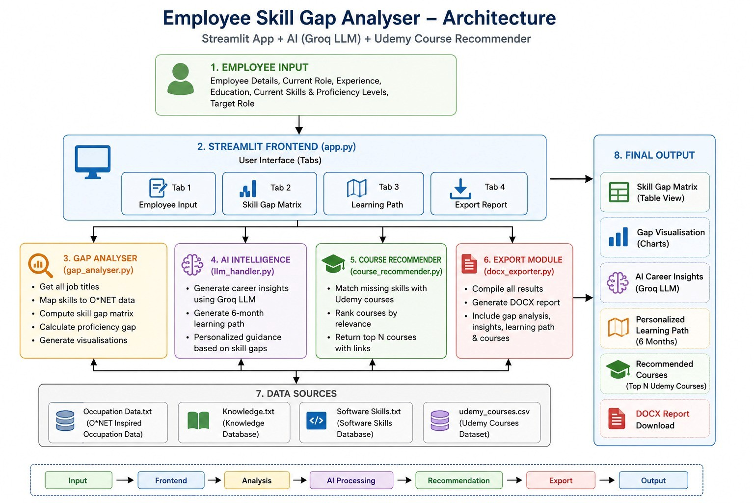
Architecture

Slide 5
Thank You…

